Slide 1
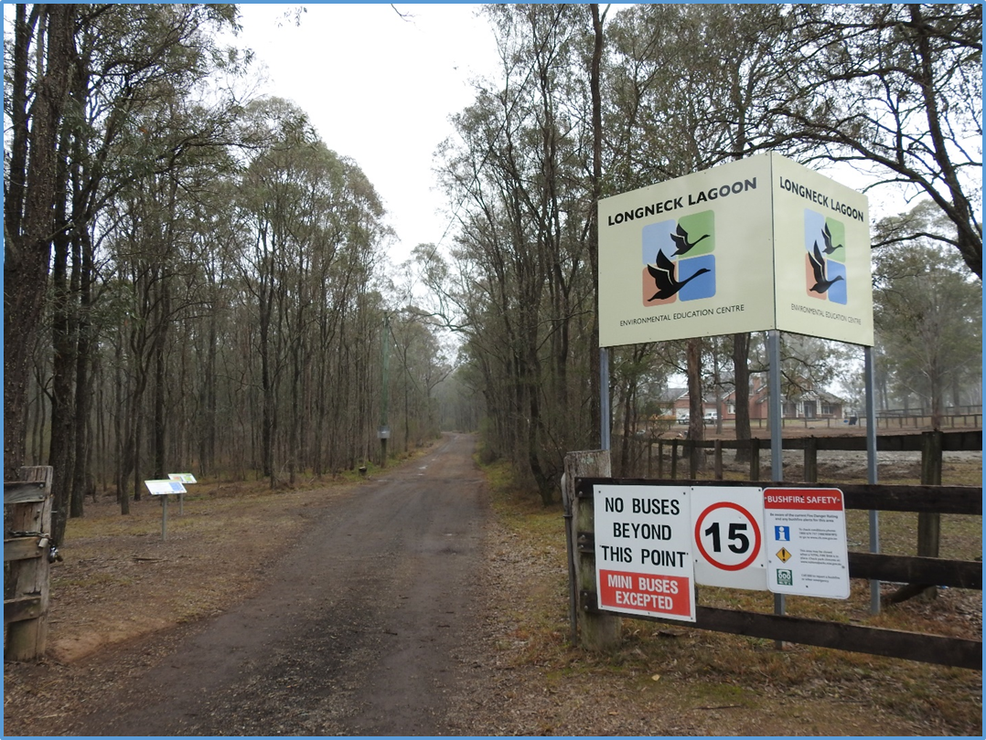
Welcome to Longneck Lagoon EEC

Slide 2
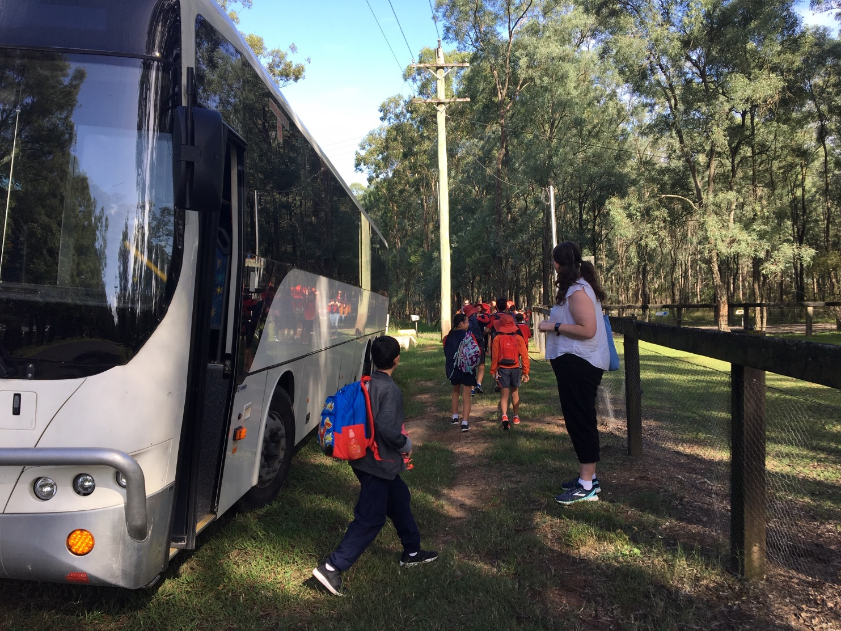
A bus will take you to Longneck Lagoon EEC.

Slide 3
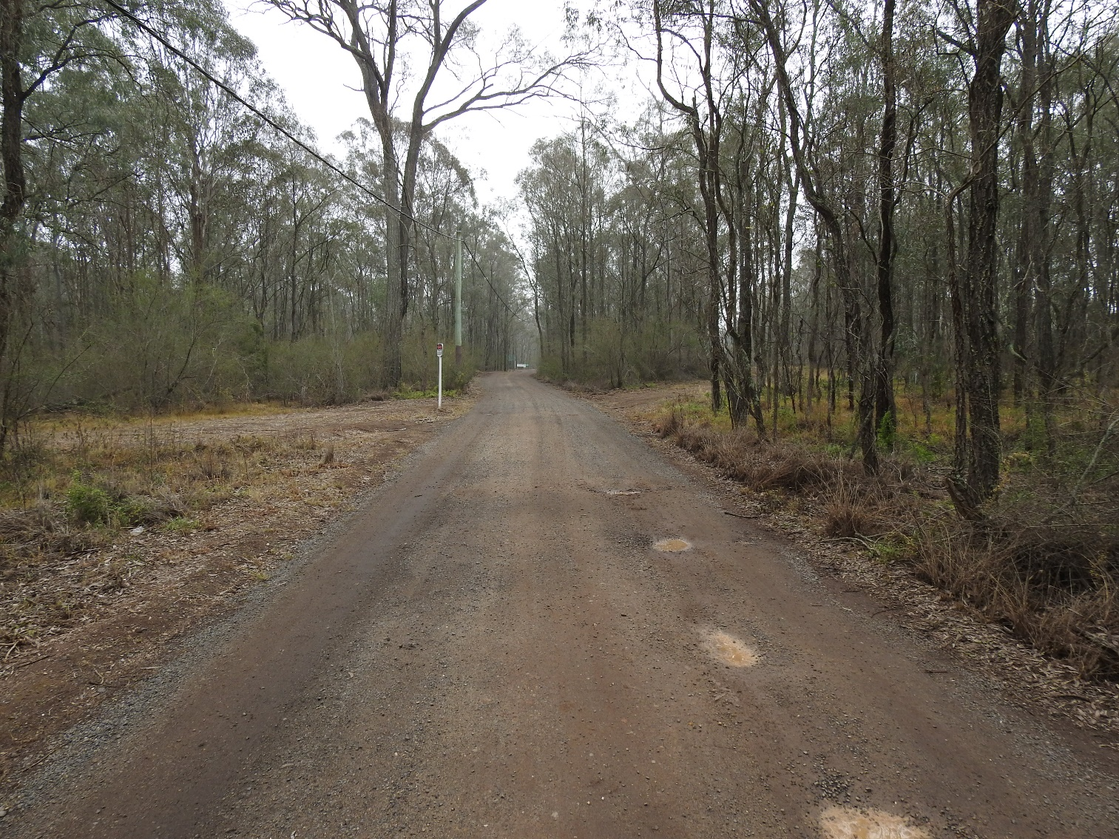
You will walk along the driveway.

Slide 4
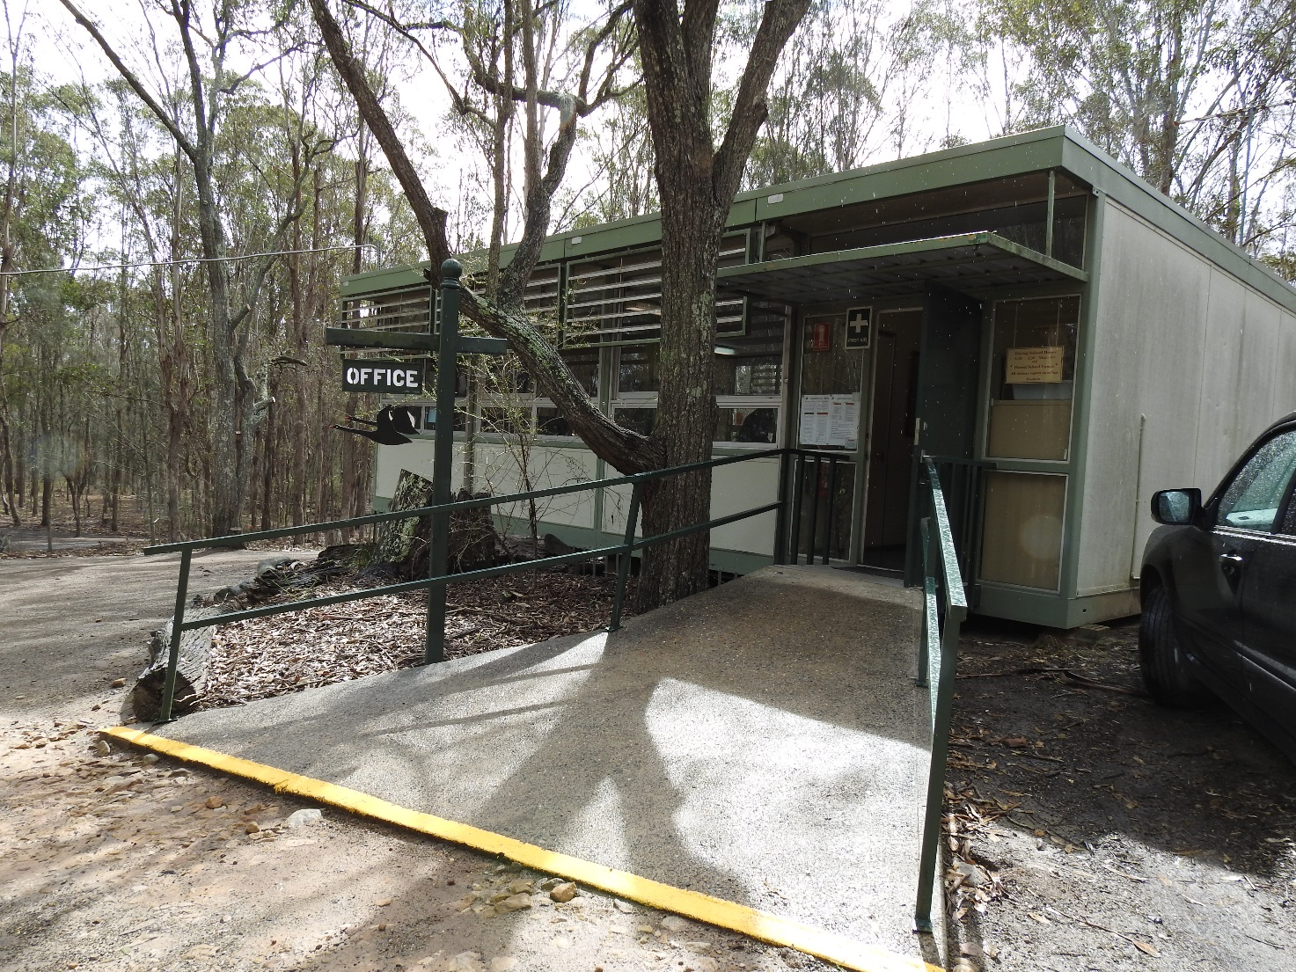
This is the office.

Slide 5
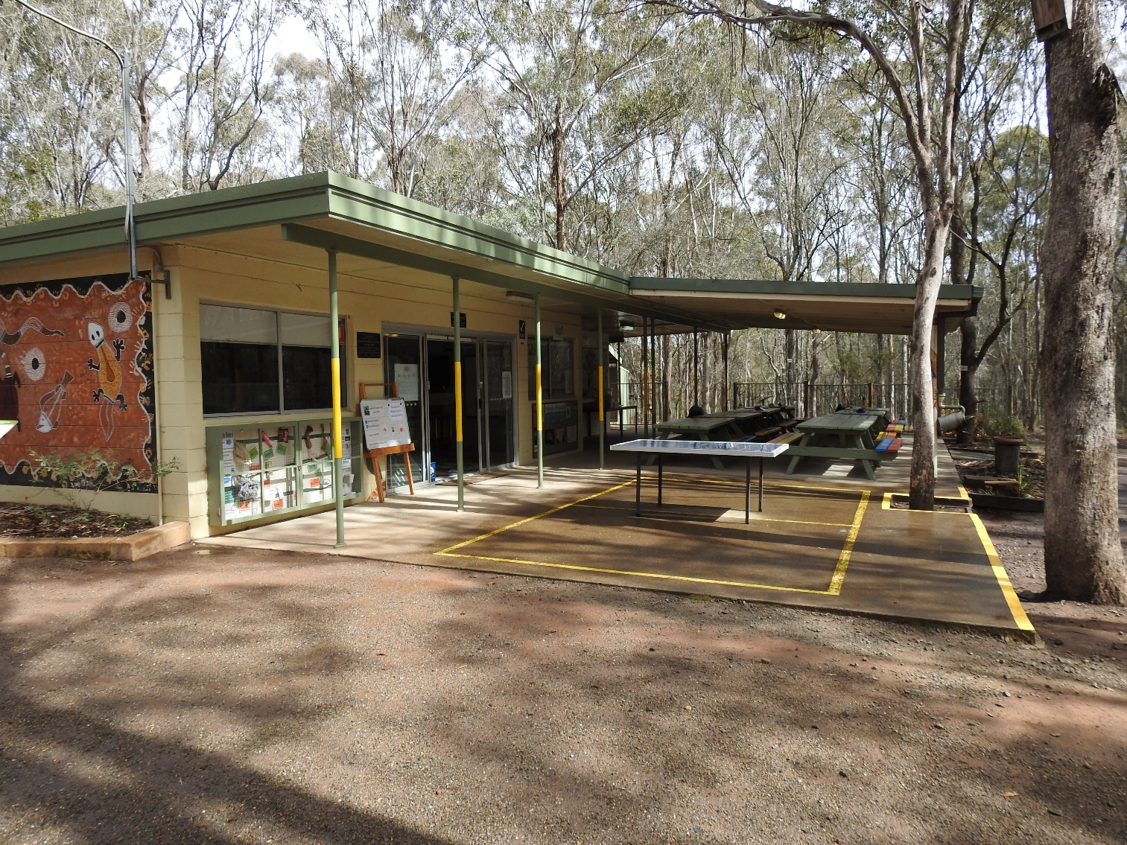
This is the classroom.

Slide 6
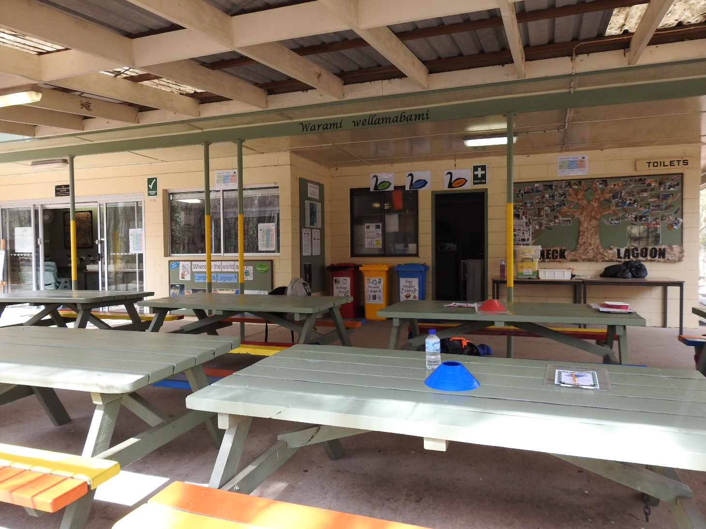
This is where you will be sitting and where you will eat your recess and lunch.

Slide 7
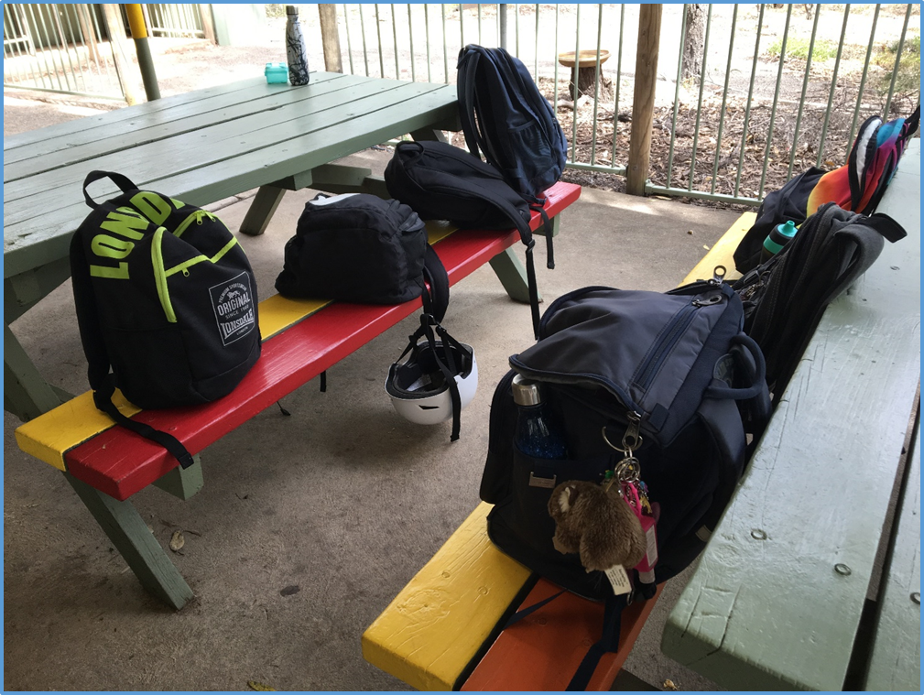
You will leave your bags here – they will be safe.

Slide 8
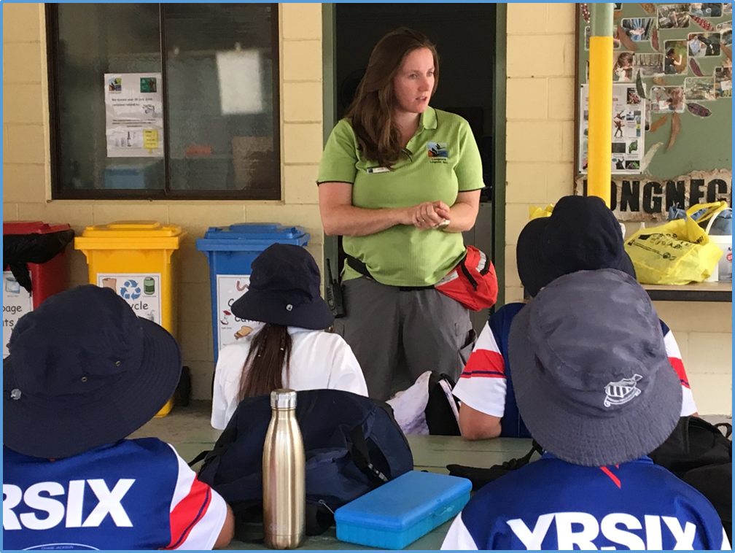
The teachers will talk to you about your day.

Slide 9
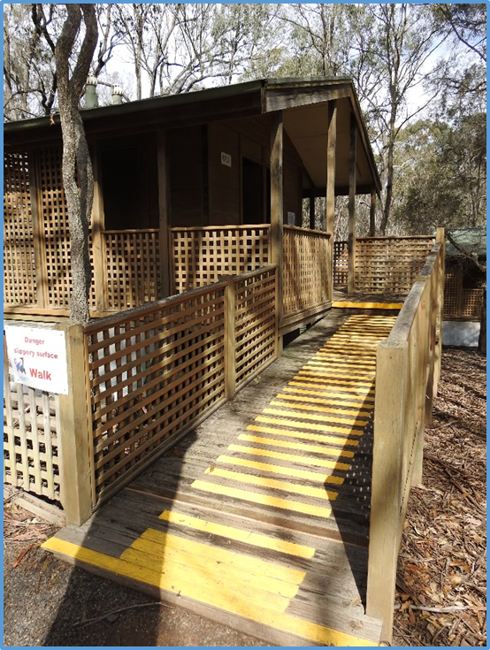
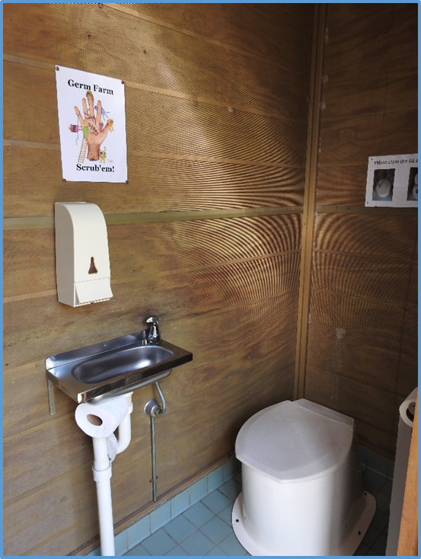
The toilets you will use are composting toilets and they will smell different.

Slide 10
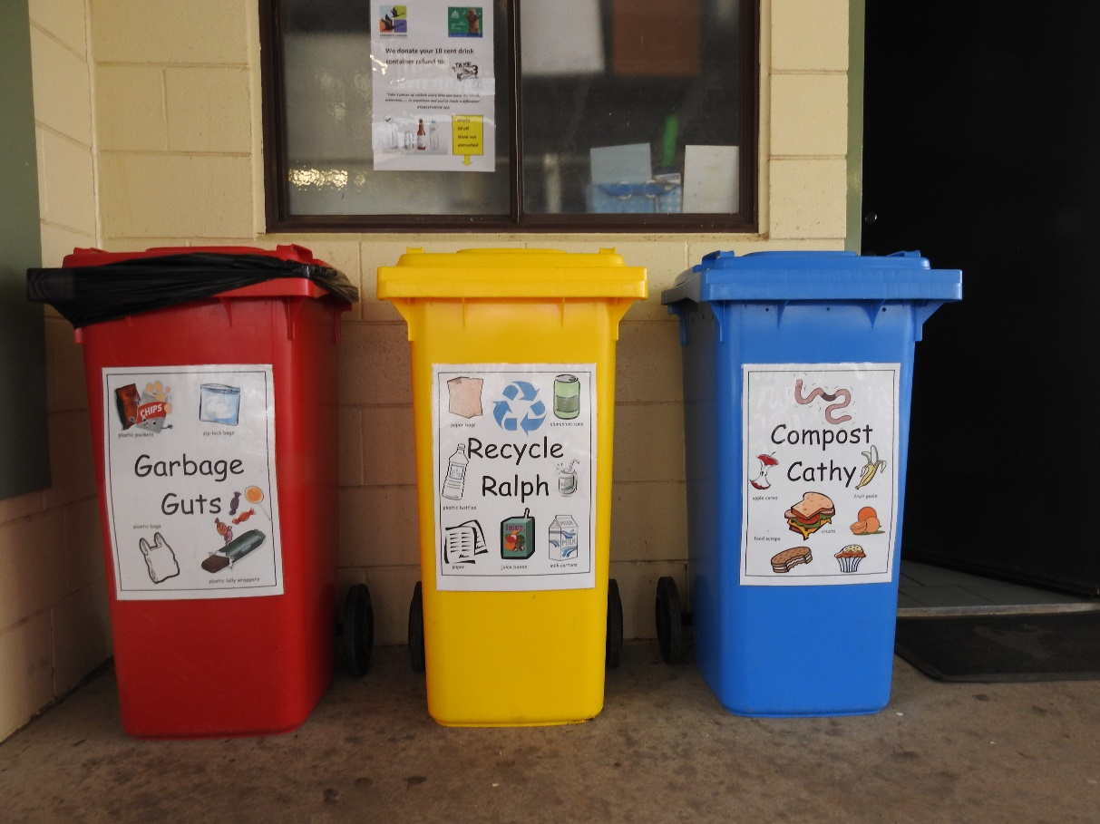
You will put your rubbish in different bins.

Slide 11
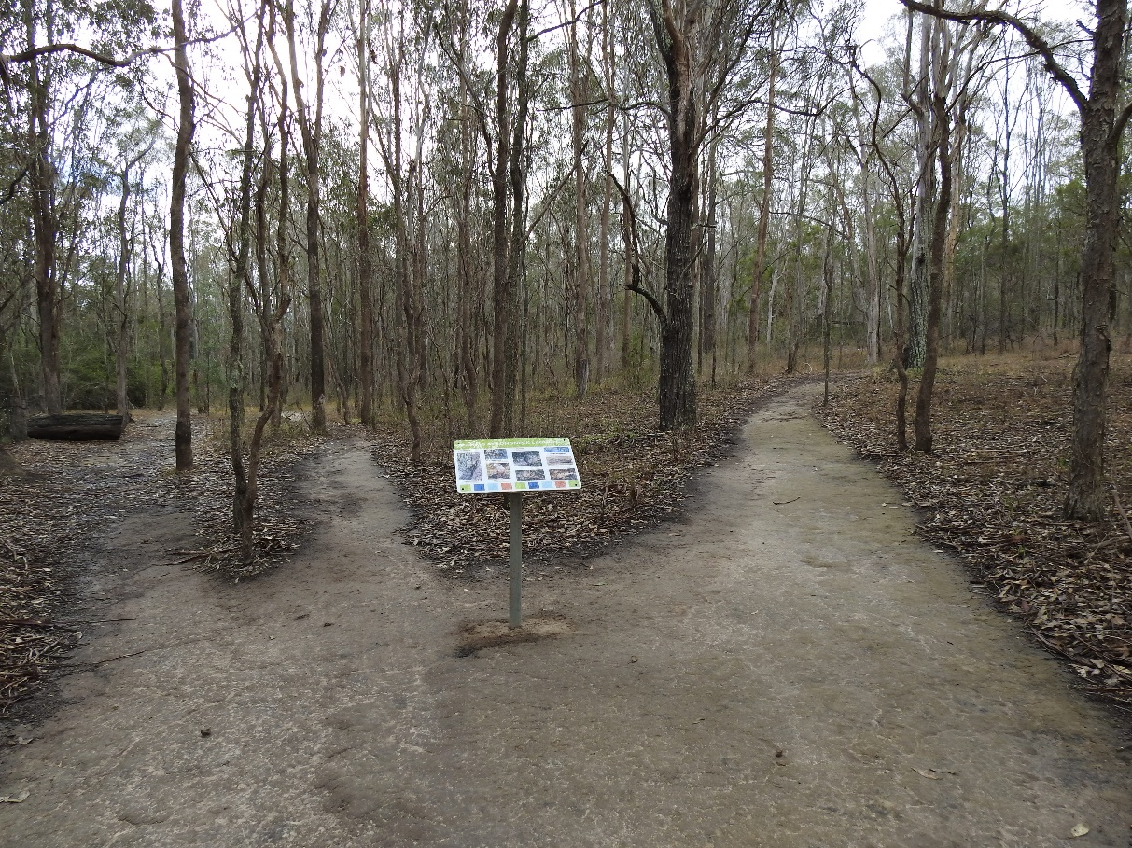
You will walk on lots of bush paths. You will see, hear and smell different things.

Slide 12
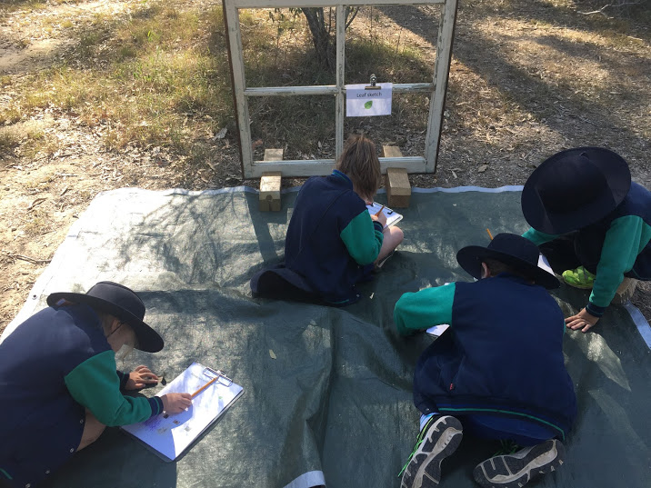
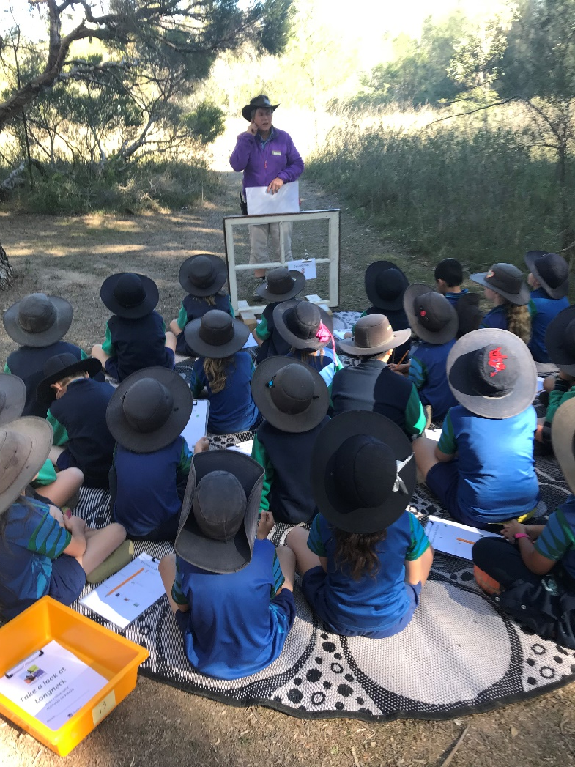
You will learn about the woodland.

Slide 13
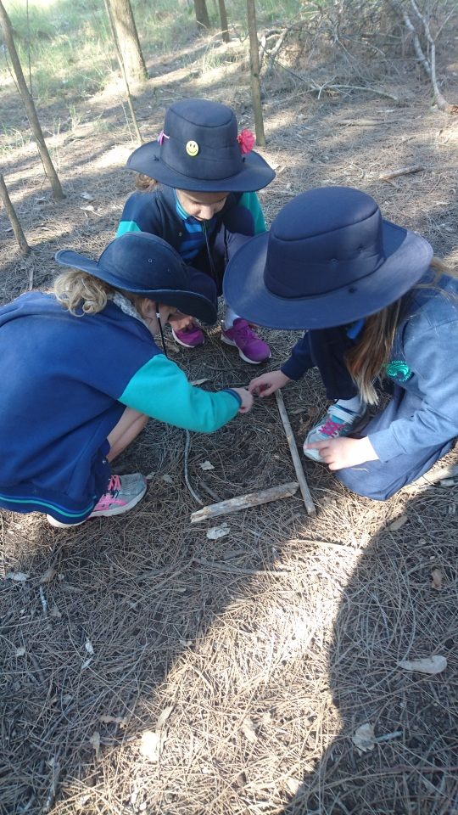
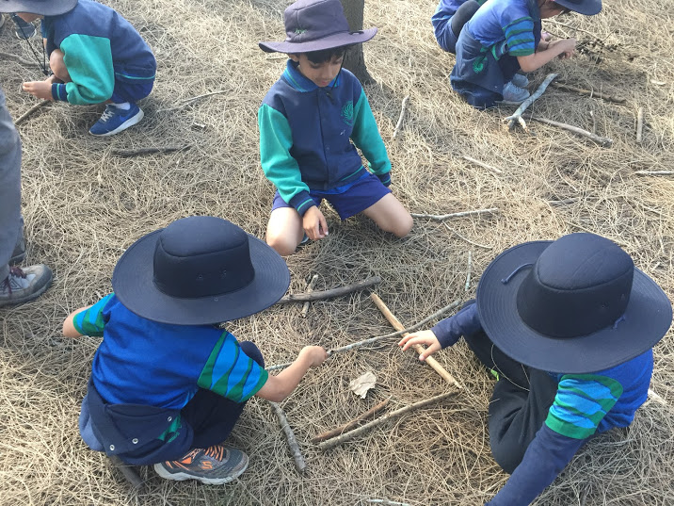
You will walk through the bush and make a map of your walk with natural objects.

Slide 14
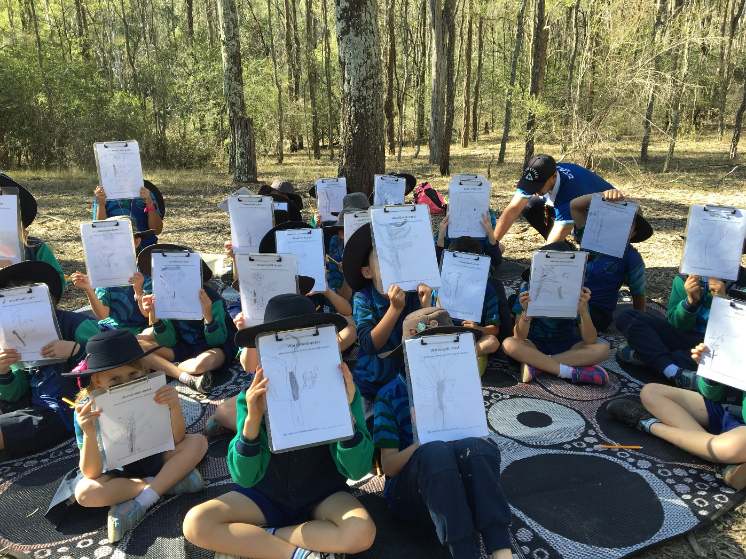
You will go on a walk looking for a new home for a possum.

Slide 15
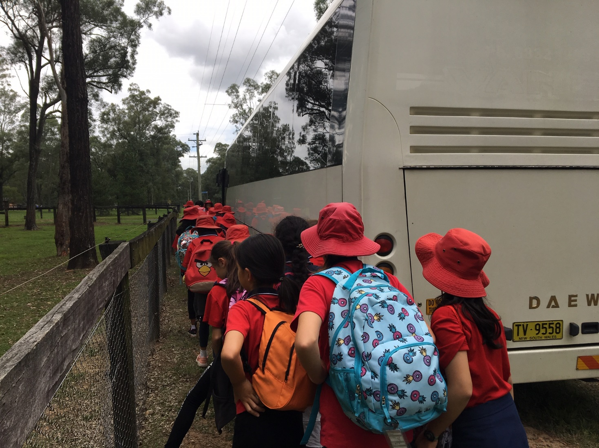
At the end of the day you will go back to school on the bus.

